Slide 1
How do you find the fastest route?

Slide 2
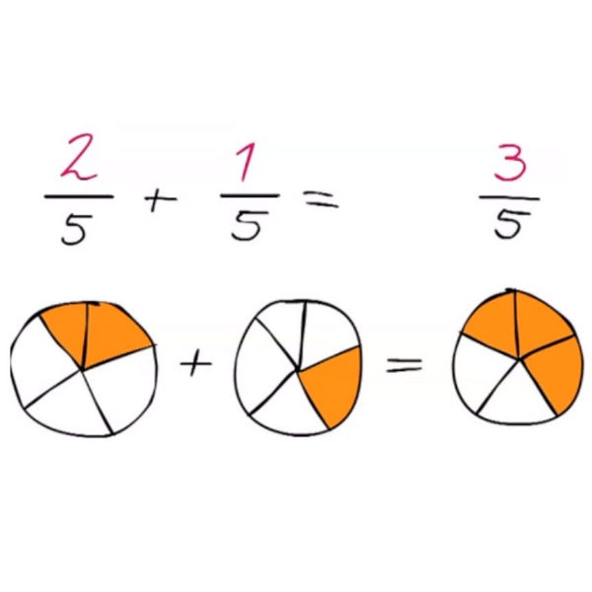
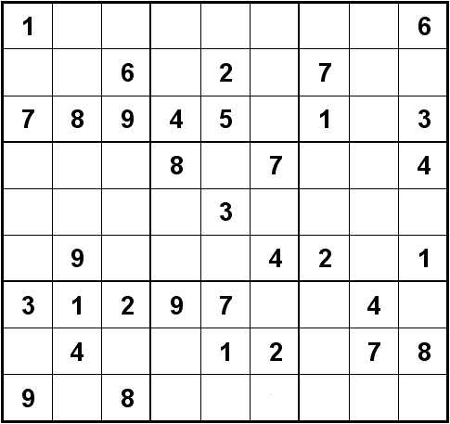
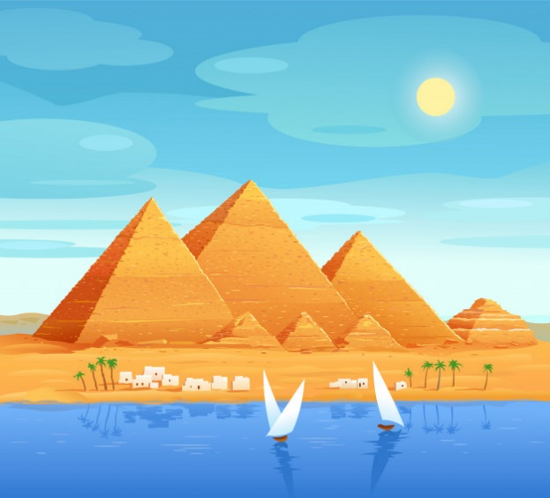
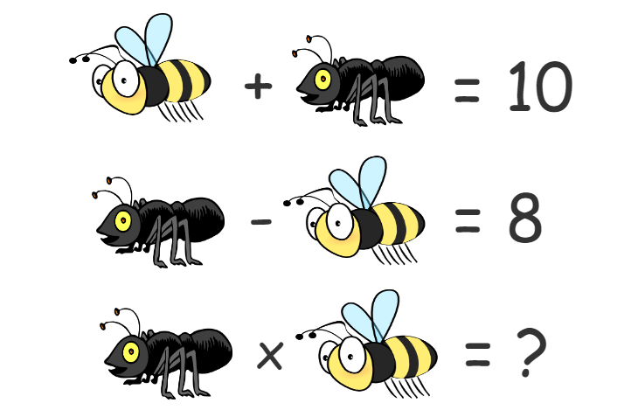
What is math?
Notes:
First ask students what they think math is about. Then give examples: math is calculating, as you learn in school, but also the calculations the Egyptians used to make sure the Pyramids have the right amount of blocks. But math is also solving puzzles like Sudoku. So mathematicians look at the world in a very abstract way. For example, they usually do not calculate with numbers, but with symbols, like in the puzzle above.

Slide 3
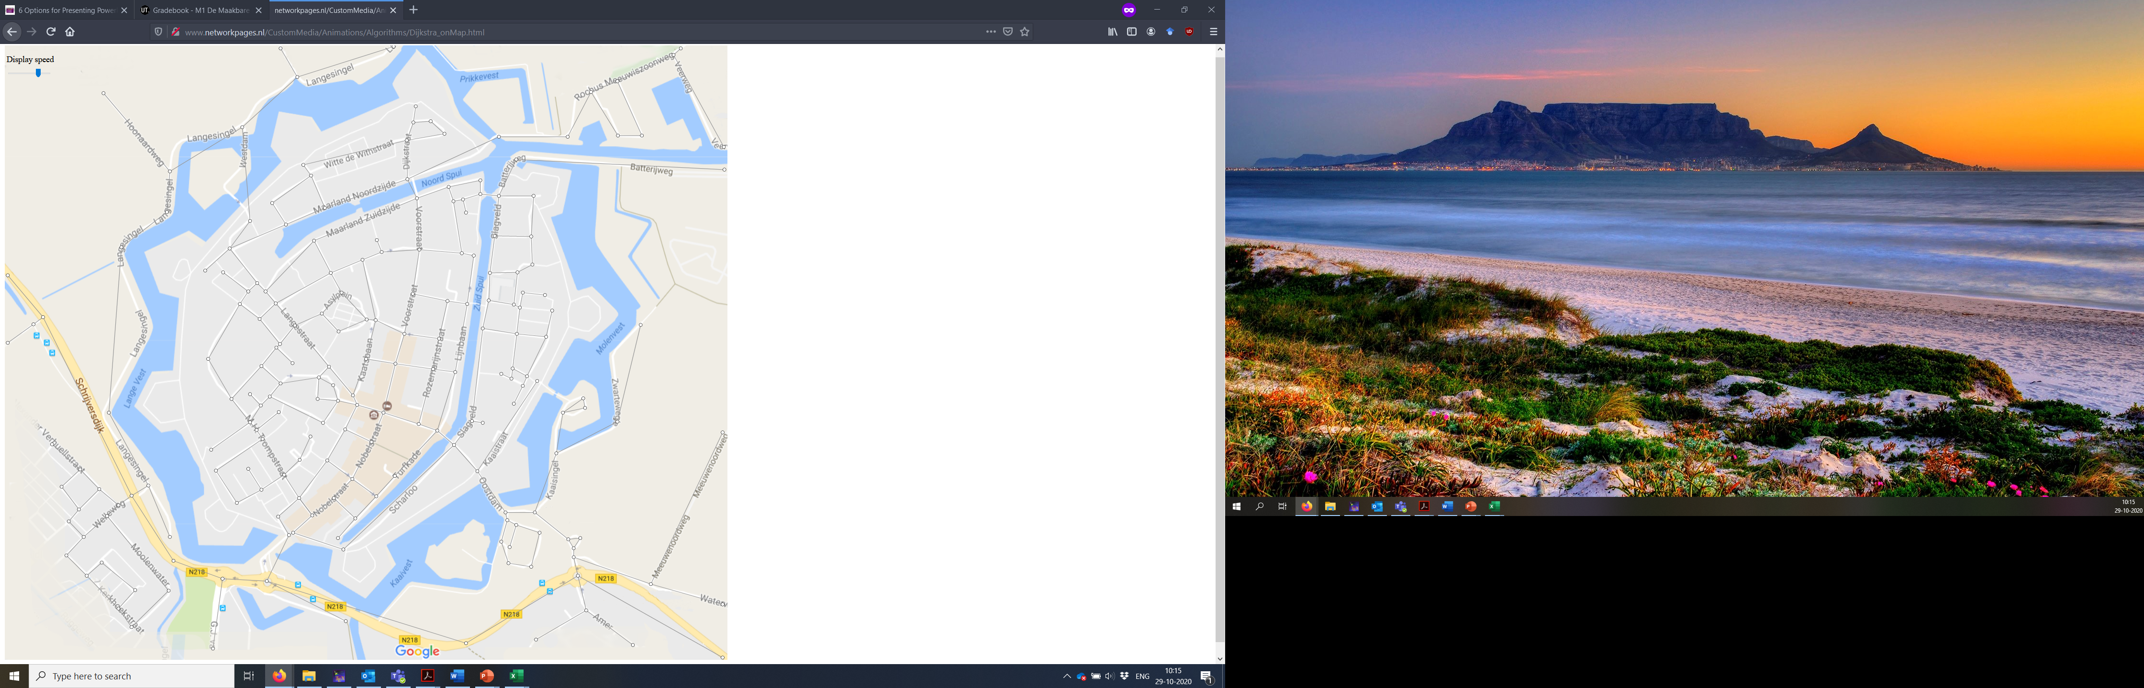
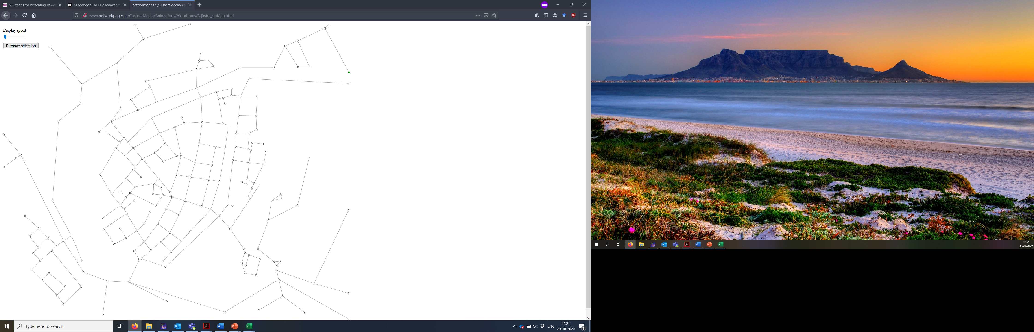
Notes:
Example of an abstract mathematician’s view: In detailed map, we see canals, bus stops and so on, but mathematicians only see a network when they look at maps like this.

Slide 4


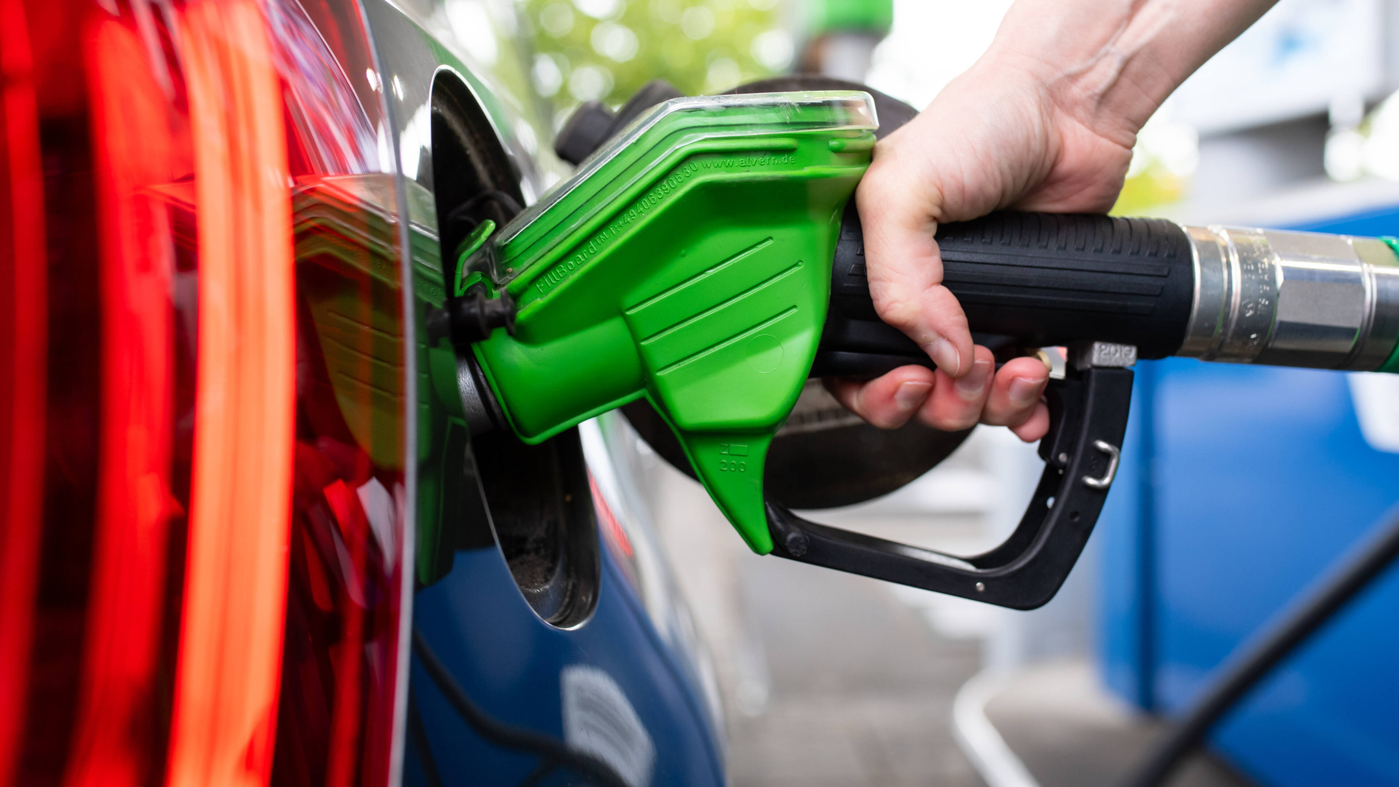
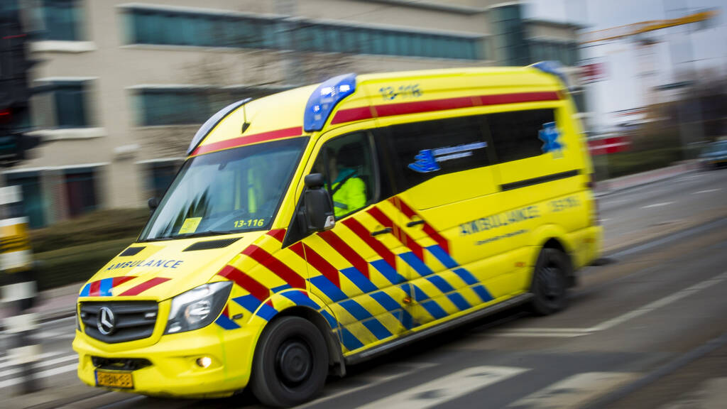
What is the fastest route?
Notes:
Question to children: why could it be important to find the fastest route? Then explain pictures: you want a hot pizza, so pizza deliverer should be fast, you do not like cars, and you would like to arrive at your holiday destination soon, you would like to save fuel, or you need to go to the hospital.

Slide 5
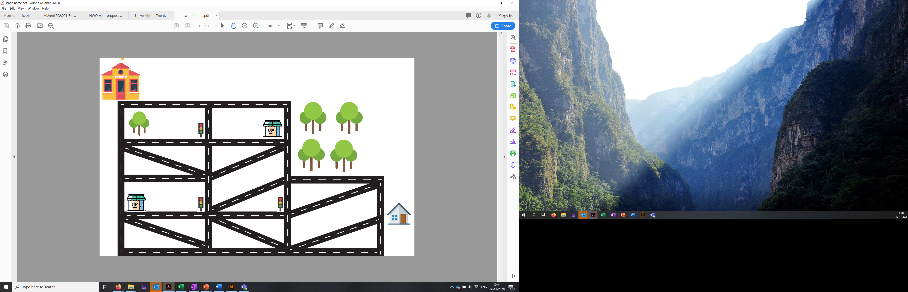
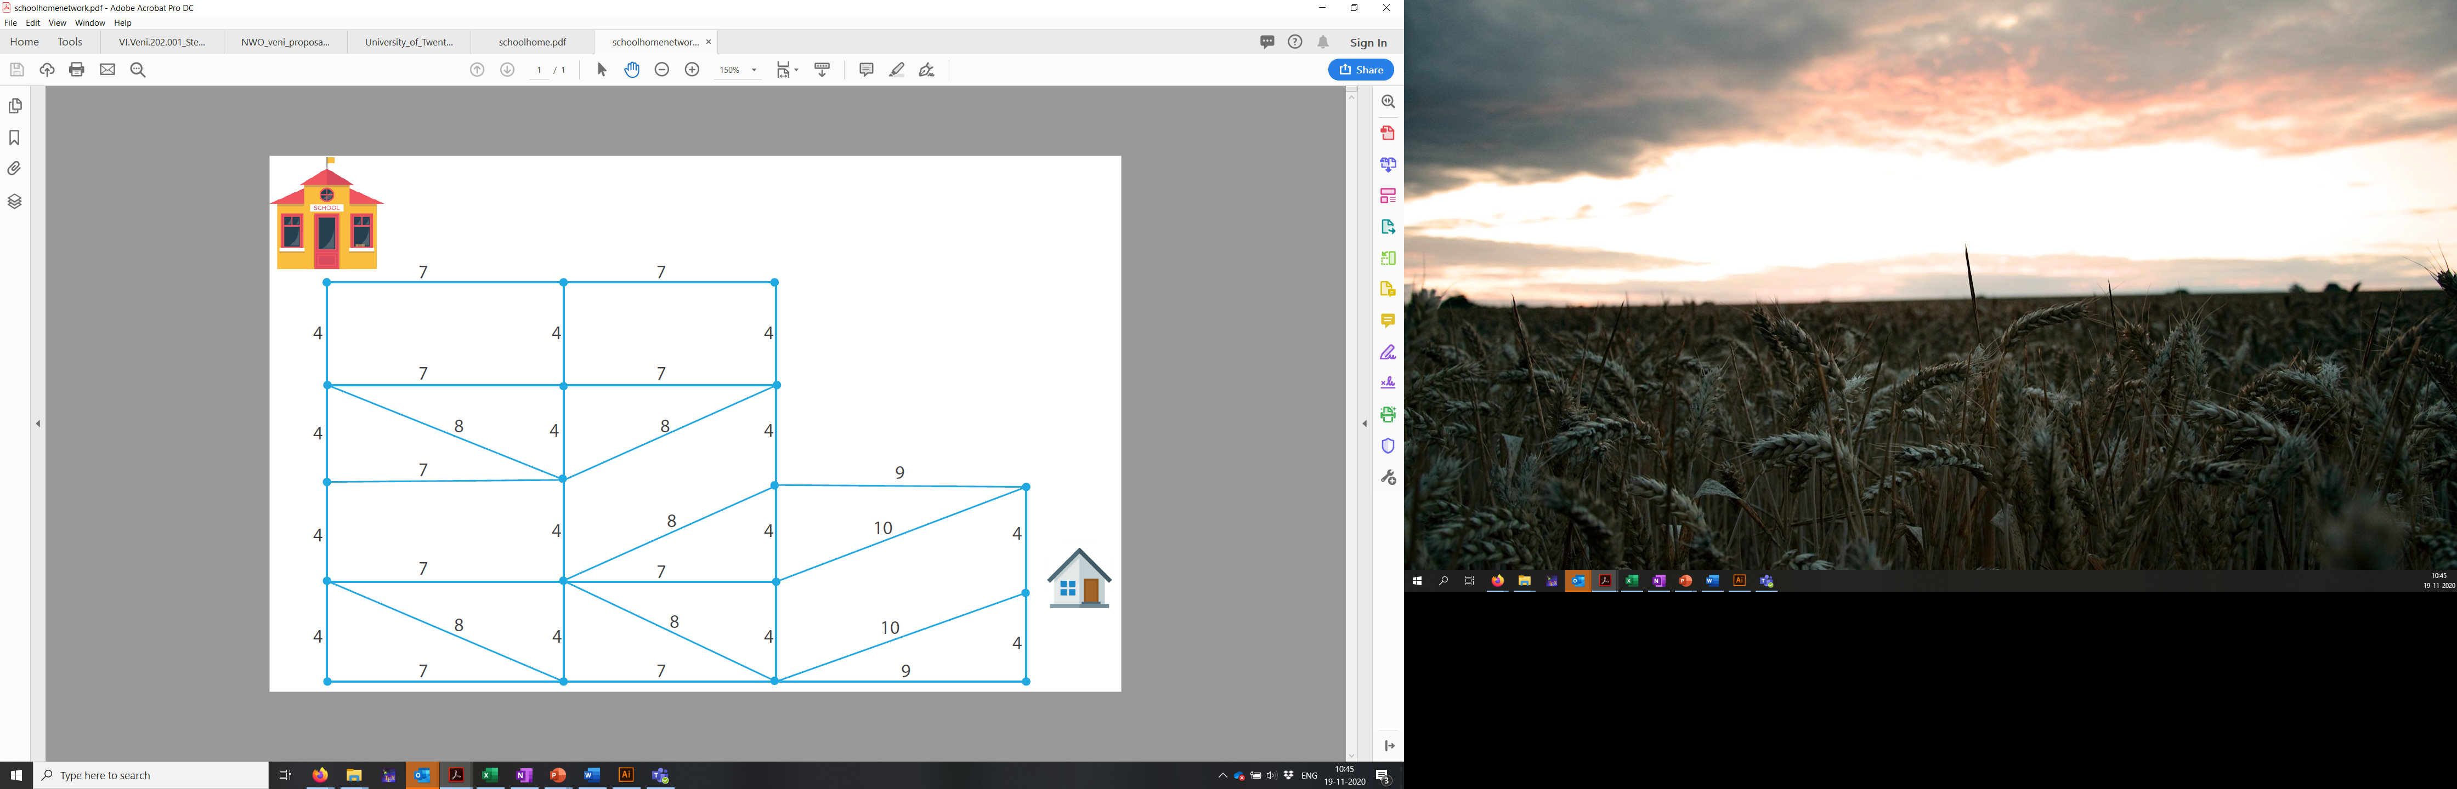
Notes:
Problem: how do we find the fastest way from home to school? By looking at map in an abstract way!

Slide 6
4+10+7=21
Notes:
Numbers indicate length. Ask children to try to find the shortest route. Example of a calculation of the sum of several routes. Then, compare children’s answers. Who believes they found the shortest route? How can you be sure?

Slide 7
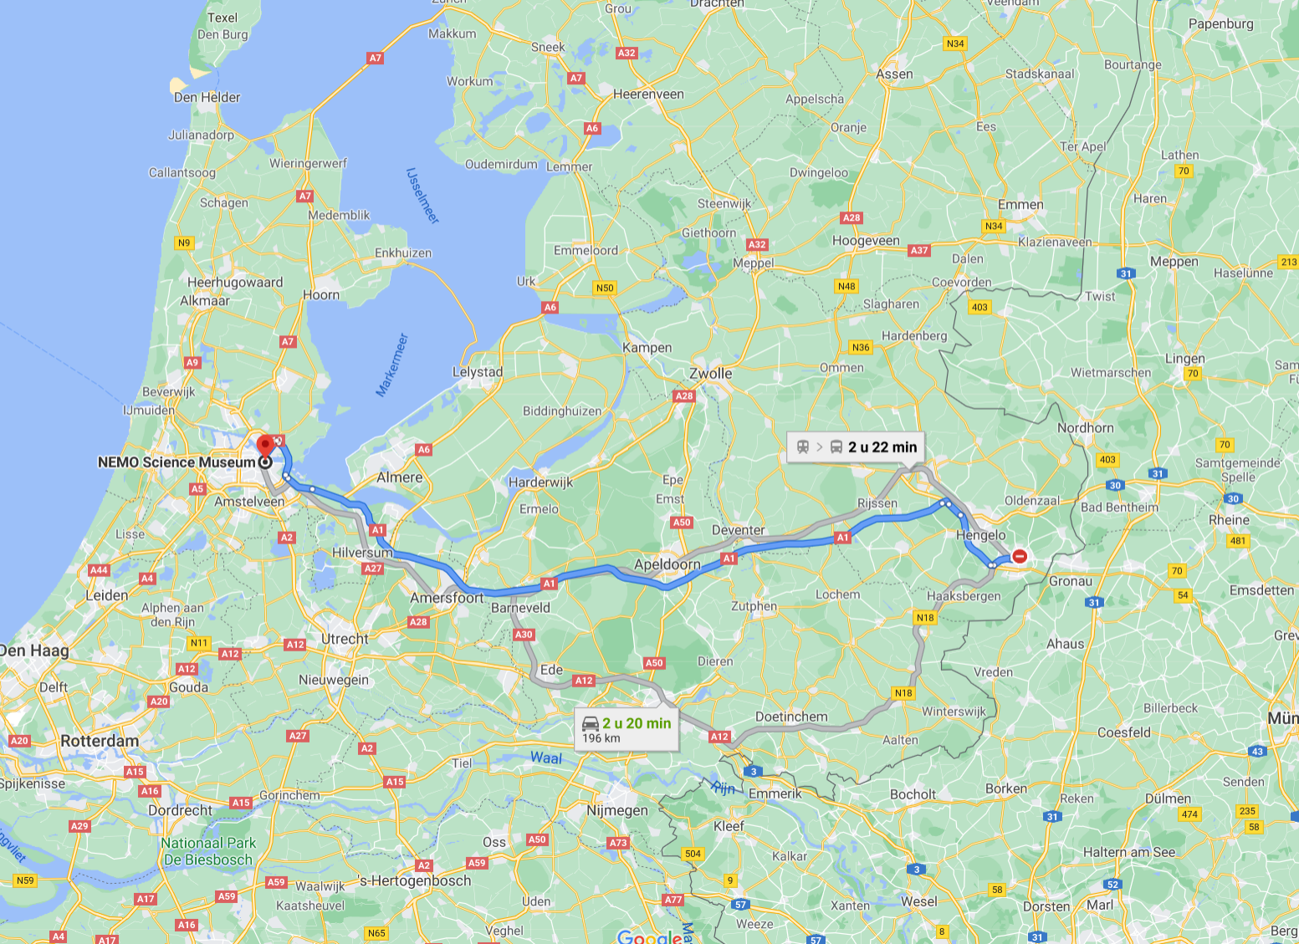
Notes:
But google maps finds the shortest route within less than a second… How does this work?

Slide 8

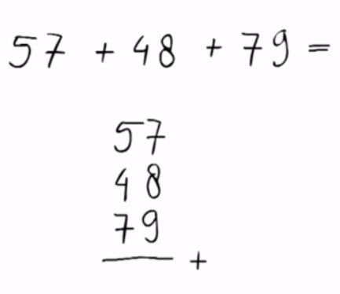
Algoritm: Rules to systematically find the solution to a problem
Notes:
By using an algorithm. Explain definition and examples of algorithms the children already know: adding numbers or making pumpkin soup.

Slide 9
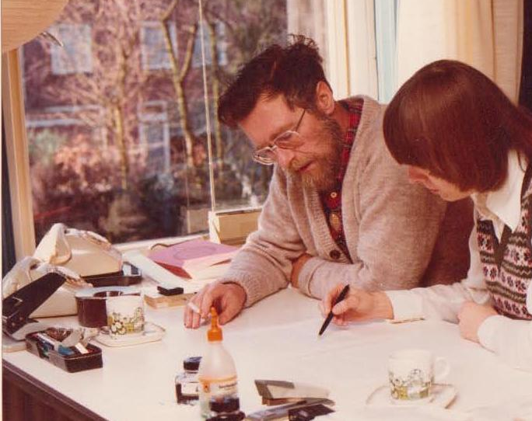
Edsger Dijkstra
http://www.networkpages.nl/CustomMedia/Animations/Algorithms/Dijkstra_onMap.html
Notes:
First, apply Dijkstra’s algorithm on the school-home network on a large flipover. Children can point to the node with the lowest number so far without a red circle and draw a red circle around it. Then, we check all neighbors, and add the value of the edge to the value of the circled node. If this is smaller than the value that is already at the neighboring node (or there is no value at all), then add this number to the neighbor. Stop when all nodes have been circled.
After that, show the animation in the link: a computer can apply this algorithm very fast on real maps!

Slide 10
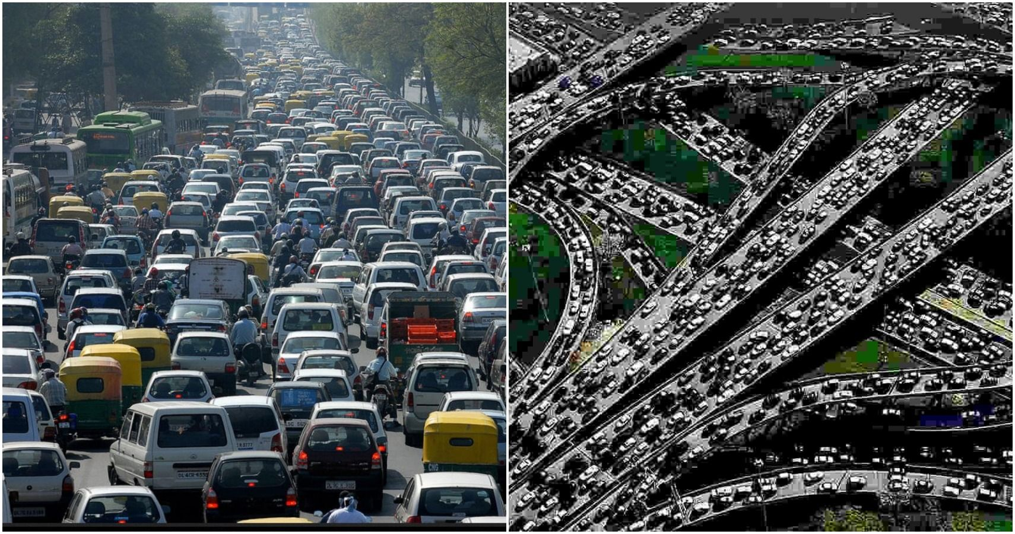
What if we all travel at the same time?

Slide 11


10 cars
N: number of cars on the road
N min
15 min
15 min
N min
Notes:
Explain what N means: 2 cars, means travel time is 2 minutes. The more cars, the more traffic, the slower it becomes. Then invite 10 children for the experiment described.

Slide 12
 | Travel time top road | Travel time bottom road
9 top road, 1 bottom road | 9+15=24 | 15+1=16
8 top road, 2 bottom road | 8+15=23 | 15+2=17
7 top road, 3 bottom road | 7+15=22 | 15+3=18
6 top road, 4 bottom road | 6+15=21 | 15+4=19
5 top road, 5 bottom road | 5+15=20 | 15+5=20
4 top road, 6 bottom road | 4+15=19 | 15+6=21
3 top road, 7 bottom road | 3+15=18 | 15+7=22
2 top road, 8 bottom road | 2+15=17 | 15+8=23
1 top road, 9 bottom road | 1+15=16 | 15+9=24
 | Travel time top road | Travel time bottom road
9 top road, 1 bottom road
8 top road, 2 bottom road
7 top road, 3 bottom road
6 top road, 4 bottom road
5 top road, 5 bottom road
4 top road, 6 bottom road
3 top road, 7 bottom road
2 top road, 8 bottom road
1 top road, 9 bottom road
9+15=24
15+1=16
10 cars
N: number of cars on the road
N min
15 min
15 min
N min
Notes:
Calculation of all possible ways to divide children over the roads. Shows that indeed, 5 to the top road, 5 to the bottom road is the best for everybody.

Slide 13
200 cars
N: number of cars on the road
5 cars
N min
15 min
15 min
N min
5 cars

Slide 14
Travel time: 20 min
5 cars
5 min
15 min
15 min
5 min
5 cars

Slide 15
10 cars
N min
15 min
1 min
15 min
N min
Notes:
Now, the municipality decided to add a shortcut road to save time. This road only takes 1 minute. What will everyone do now? Invite children to try this out live.

Slide 16
10 cars
10 cars
N min
15 min
1 min
15 min
N min
Notes:
Explain why this is indeed the fastest route

Slide 17
Travel time: 21 min
Travel time without extra road: 20 min
10 cars
10 min
15 min
1 min
15 min
10 min
Notes:
Ask what is weird here

Slide 18

Braess Paradox
‘Closing roads can improve traffic’
Notes:
Explain: in mathematics, something that is weird but still true is called a paradox. And this is the paradox that mr. Braess found out.

Slide 19
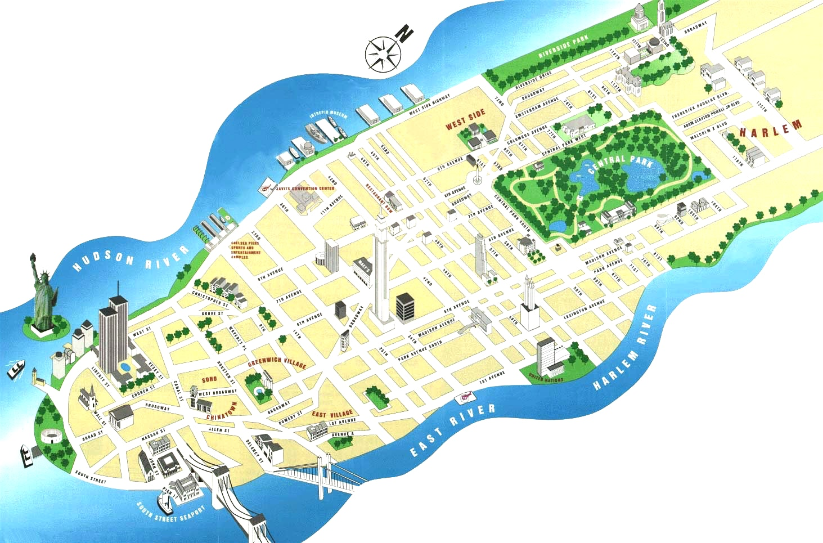
Notes:
This paradox also appears in reality: at some point 42nd street in New York had to be shut down for maintenance.

Slide 20
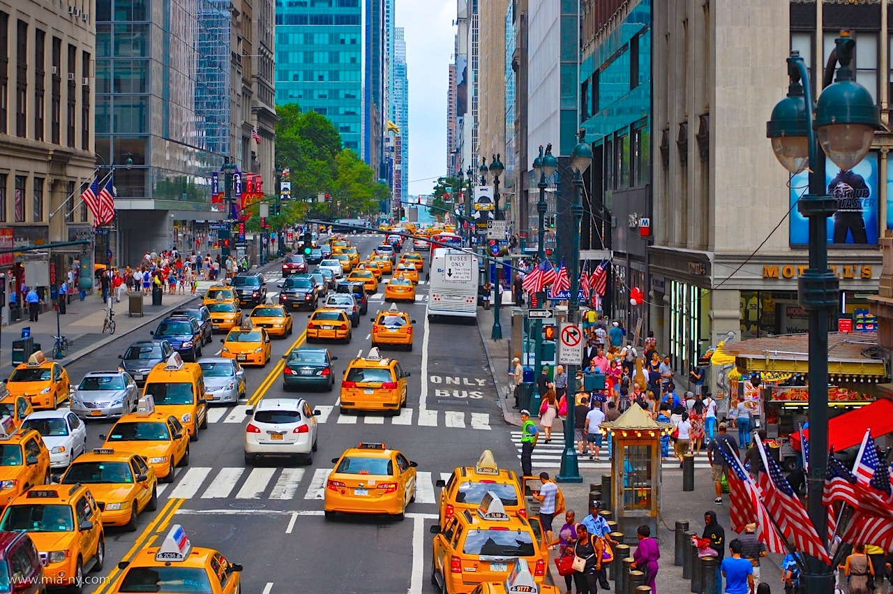
Notes:
This is how crowded 42nd street usually is

Slide 21
Notes:
But when it closed, nothing bad happened to traffic at all!

Slide 22
10 cars
N min
15 min
1 min
15 min
N min
Notes:
So 42nd street is an example of the extra ‘middle’ road that does not help.

Slide 23
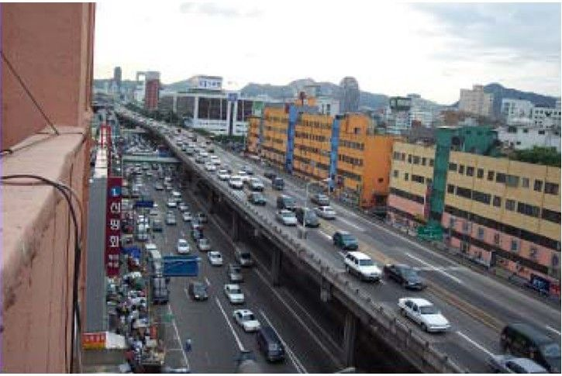
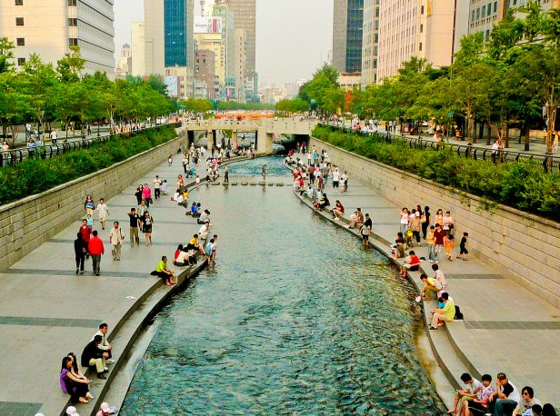
Before
After
Notes:
In some countries, they calculate their entire traffic network to see which roads are maybe not necessary. In Seoul, they found that this road was actually not good for traffic at all. Ask what children would do with this road, and then show what the city government decided to do with it.

Slide 24
But what if we would like to visit many places?

Slide 25
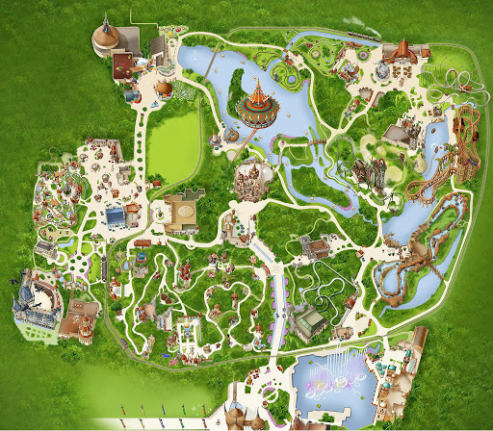

Notes:
Goal: visit all favorite attractions in theme park

Slide 26




Notes:
Or: deliver all packages, gifts, mail or children to home. (as fast as possible)

Slide 27

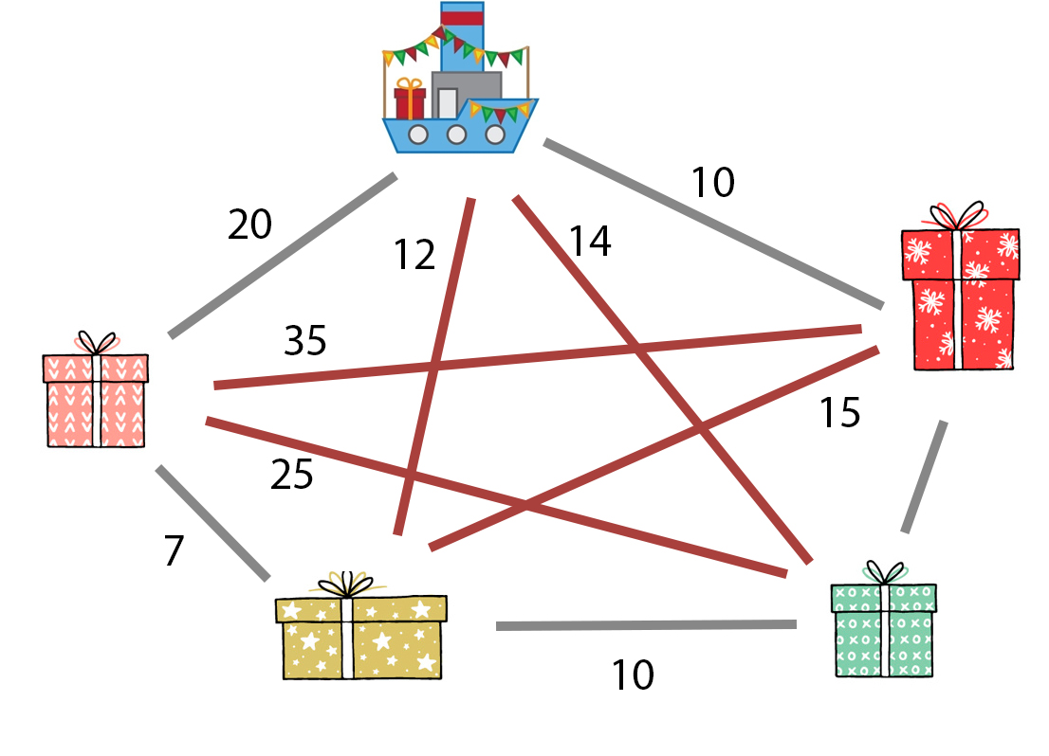
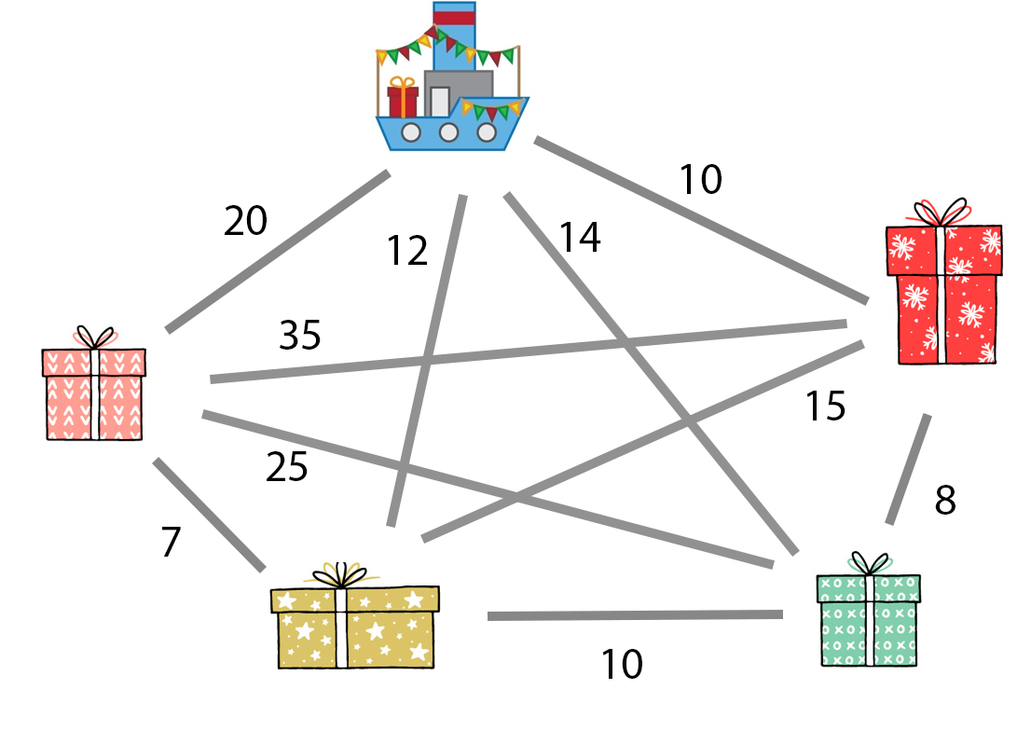
12 + 15 + 35 + 25 + 14 = 101
Notes:
Example: deliverer leaves factory, and has to deliver 4 packages, and then return to his work. His travel time is the sum of all the individual routes. One example here.

Slide 28
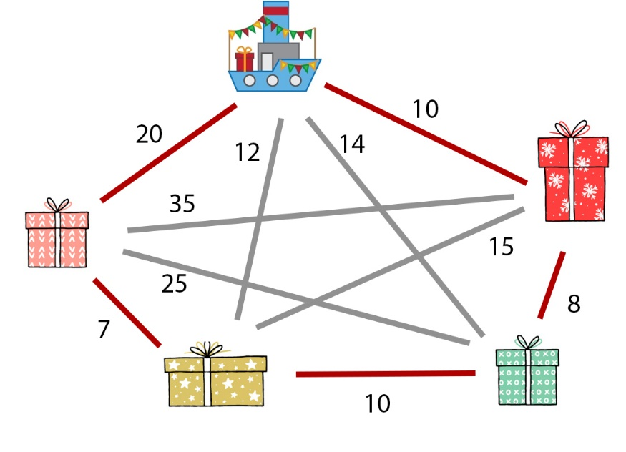
20 + 7 + 10 + 8 + 10 = 55
Notes:
Another example shows a shorter route. But how can we know which one is the shortest? Easiest way is calculating all possible routes and selecting the shortest one.

Slide 29
In how many ways can the deliverer deliver these packages?
a) 10
b) 24
c) 48
Notes:
Explain why right answer (b) is correct: first choose first package (4 ways), then second (3 ways), third (2 ways), then your route is fixed. This gives 24 possibilities.

Slide 30
Notes:
And this is the shortest one.

Slide 31
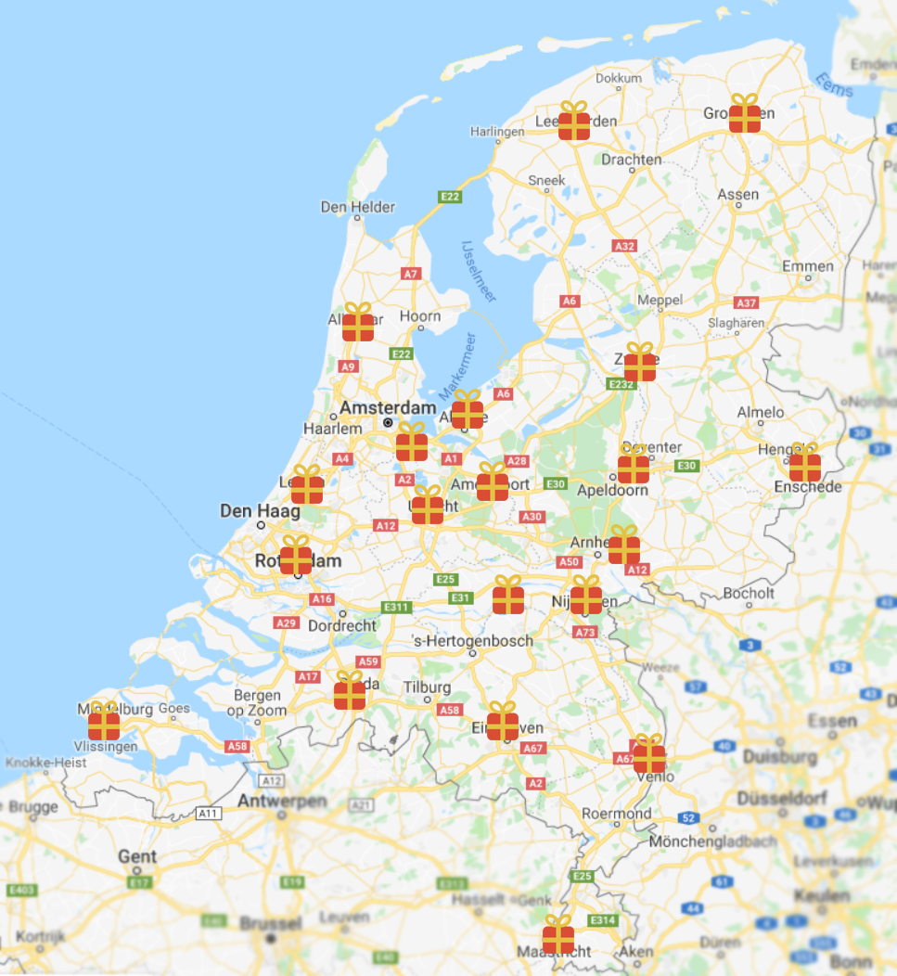
Notes:
But what if we have to deliver 20 packages?

Slide 32
In how many ways can the deliverer deliver these 20 packages?
a) 4.876.573.000
b) 1.356.735.265.000
c) 2.432.902.008.176.640.000
Notes:
Correct answer: c)

Slide 33

1.000.000 computations per second
2.432.902.008.176 seconds
675.806.113 hour
28.158.588 days
77.146 year
Notes:
Suppose a computer can calculate 1000000 such routes per second. How long would it take to check all of them to find the shortest one?

Slide 34
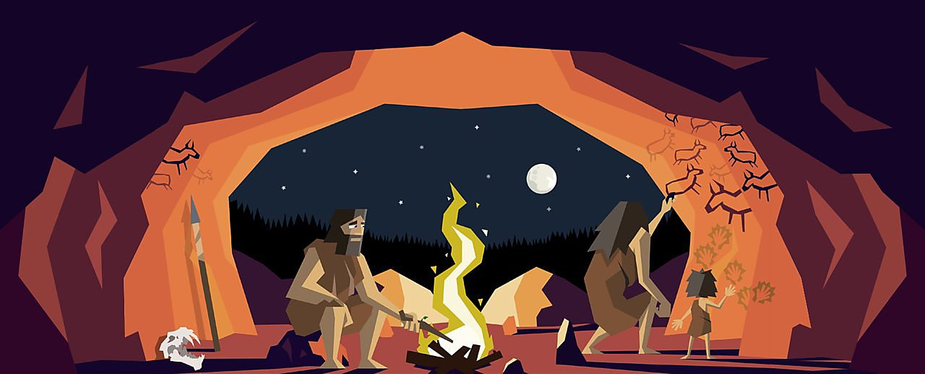
Notes:
This means a prehistoric human must have started to computer!

Slide 35

Notes:
And for 25 packages, a dinosaur should have started the computer!

Slide 36
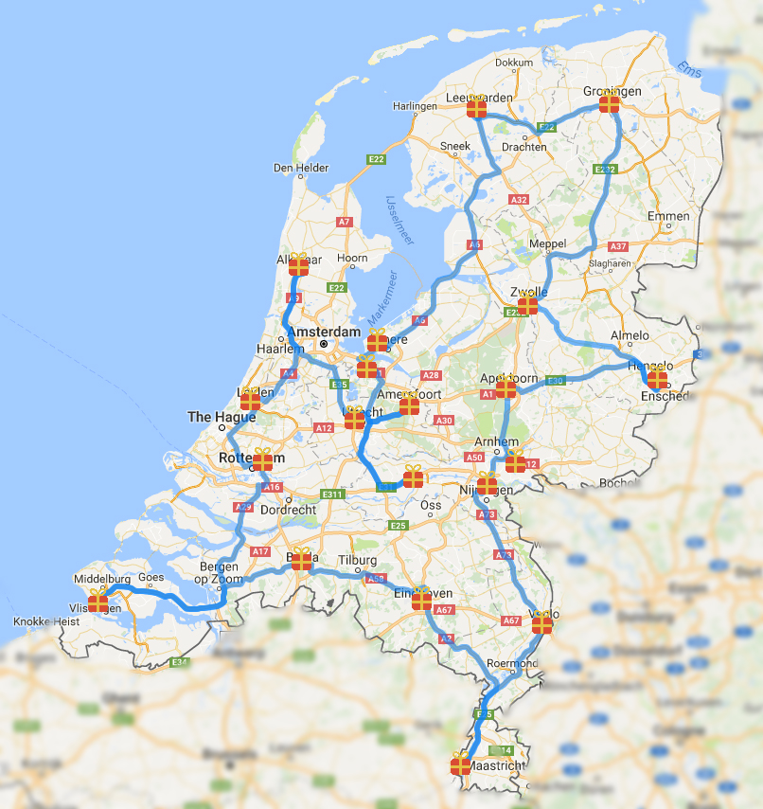
Notes:
Of course, we still have computer programs that can generate a route through the 20 packages that looks not too long. This is an example of such a route. But we do not know if it is actually the shortest one

Slide 37
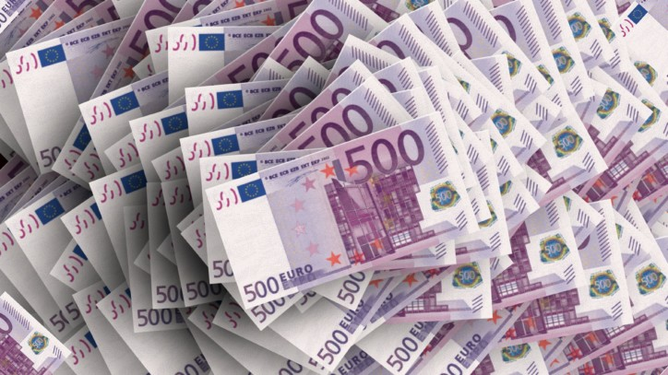
Notes:
If you do manage to find a way to quickly calculate the shortest route through many packages, for example an algorithm such as Dijkstra’s algorithm, you will be awarded 1 million dollar by the Clay’s institute for mathematics. They created a list with important problems for which they award money in 2000, but this one has not been solved yet! You will also get the money if you show that no such algorithm is possible. Most mathematicians believe that this is actually the case.

Slide 38
How do you find the fastest route?
Notes:
Short recap of the lecture

